Slide 1

FinTech – Then and Now How Technology is Disrupting Industry
Byte Academy
Friday, April 20, 2018

Slide 2

FinTech
A techpreneur countercultural movement to upend traditional banking and lending’s heavy regulation and strong resistance to change in order to make sending and receiving money easier.
An economic industry composed of firms that use technology to make financial systems more efficient.
A very young industry, no more than 10 years old.

Slide 3
FinTech
Earlier scenario
Regulated environment
Bank Centric operations/IT dept of institutions
Large Mainframe/Minicomputer based systems
Large server based systems – Securities trading systems
Emergence of the “Customer Centric Delivery Model” – Delivery at customer location
Emergence of the Client-Server based systems – Electronic banking systems
Emergence of the web based systems – Investment Bank on the web, products

Slide 4
FinTech
Current Scenario
Emergence of startups that are challenging conventional models and regulations, challenging conventional technology & processes
Emergence of applications that are Disruptive, Innovative, Re-engineering, Biometrics based, Customer Experience – Aadhaar based applications, technology revolution in other countries too
Emergence of mobile based applications, Sophisticated web based applications, applications on other devices.
Cuts across - Retail Banking, Lending and Financing, Wealth and Asset Management, Markets and Exchanges, Payments and Transfers, Insurance, Cryptocurrency and Blockchain etc.

Slide 5
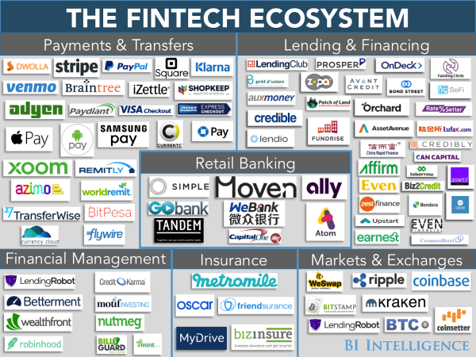
FinTech

Slide 6
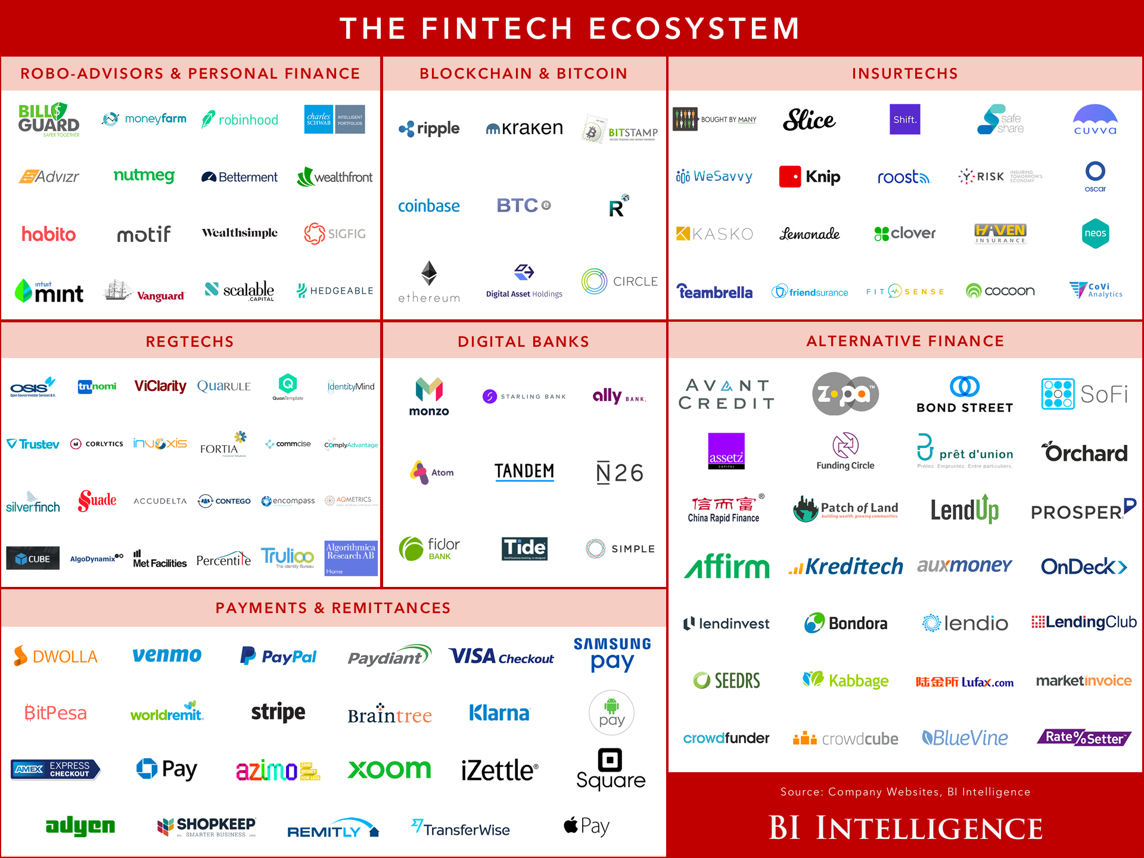
FinTech

Slide 7
FinTech
Positive Outcome
Openness in traditional financial institutions - Open innovation is at the heart of the digital revolution. Brought about openness in experimenting with new technologies, knowledge capital and resources, opening up the organization’s IP, generation of new ideas, change organizational culture, identify and attract new skills and resources, and discover new areas for growth.
Collaboration. Traditionally, traditional financial institutions have partnered with others in their own industry for lowering costs, now collaborating , to build ties with those in different industries and with different outlooks, and to identify new ways to generate value.
Investment. Venture investing has always been at the heart of the start-up innovation model. Now, more than ever, established financial institutions are taking this route to try and generate innovation for their business.

Slide 8
FinTech
Challenges
Traditional institutions are investing more heavily in innovation, but face challenges in percolating innovations throughout their organizations, need to find common ground between developing new platforms versus overcoming legacy infrastructure;
Startups are trying to navigate the regulatory landscape with innovative financial solutions, but have to find a way to scale out their business while facing increased regulations, higher costs, and larger infrastructures that will be more difficult to change and manage.

Slide 9
FinTech
Future
Blockchain – Technology which in a nutshell stores and records Bitcoin transactions.
This technology is expected to have wide-ranging impact on financial industry.
Both traditional institutions and startups are exploring this technology.
This technology could lower the cost of many financial transactions and activities significantly, almost near-zero.
Reduce operating costs. Disruptive and could disinter mediate many financial processes.

Slide 10
FinTech
Questions?

